Slide 1


Slide 2
Objective
Study 4-bit full adder, IC
Add two BCD numbers using 4-bit full adders
CSE 226: Digital Logic Design Lab

Slide 3
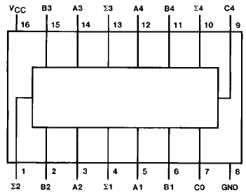
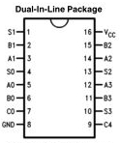
74283 4-bit Full Adder

Slide 4
How BCD adder works
Recall from theory
  Add two BCD numbers (4 bit binary numbers from 0 to 9)
  If the sum is less than 9 do nothing
  If the sum is greater than 9 (from 10 to 19) add 0110 or 6 and there will be a carry for the next level
How to achieve that special case, i.e., greater than 9?
We have to identify two cases
  From 10 to 15
  From 16 to 19
CSE 226: Digital Logic Design Lab

Slide 5
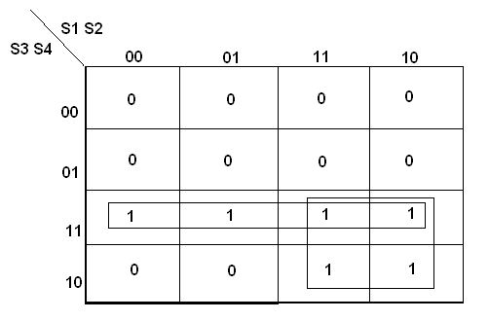
Case 1: from 10 to 15
BCD SUM |  |  |  | CARRY
S3 | S2 | S1 | S0 | C
0 | 0 | 0 | 0 | 0
0 | 0 | 0 | 1 | 0
0 | 0 | 1 | 0 | 0
0 | 0 | 1 | 1 | 0
0 | 1 | 0 | 0 | 0
0 | 1 | 0 | 1 | 0
0 | 1 | 1 | 0 | 0
0 | 1 | 1 | 1 | 0
1 | 0 | 0 | 0 | 0
1 | 0 | 0 | 1 | 0
1 | 0 | 1 | 0 | 1
1 | 0 | 1 | 1 | 1
1 | 1 | 0 | 0 | 1
1 | 1 | 0 | 1 | 1
1 | 1 | 1 | 0 | 1
1 | 1 | 1 | 1 | 1
S1.S0
S3.S2
Y1 = S3.S2 + S3.S1
CSE 226: Digital Logic Design Lab

Slide 6
Case 2: from 16 to 19
The carry-out of the 4-bit binary adder will be 1
CSE 226: Digital Logic Design Lab

Slide 7
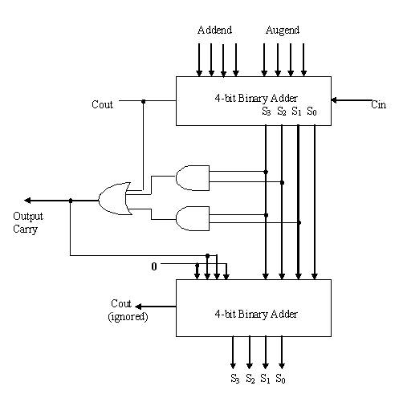
Complete Implementation
Y2
Y = Y1 + Y2
Y1 = S3.S2 + S3.S1
CSE 226: Digital Logic Design Lab

Slide 8
Writing Report
Description of 74283
Detailed Implementation
Answer following two questions
  Why did we add ‘6’ for some special cases?
  How is the carry of BCD adder has been determined?
CSE 226: Digital Logic Design Lab

